Slide 1
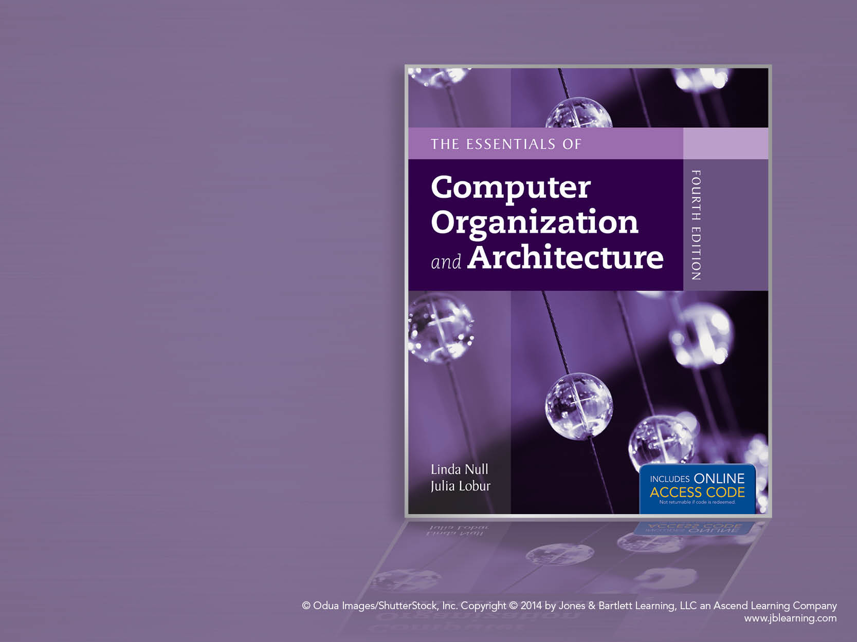
Chapter 7
Input/Output and Storage Systems

Slide 2
Chapter 7 Objectives
Understand how I/O systems work, including I/O methods and architectures.
Become familiar with storage media, and the differences in their respective formats.
Understand how RAID improves disk performance and reliability, and which RAID systems are most useful today.
Be familiar with emerging data storage technologies and the barriers that remain to be overcome.

Slide 3
7.1 Introduction
Data storage and retrieval is one of the primary functions of computer systems.
One could easily make the argument that computers are more useful to us as data storage and retrieval devices than they are as computational machines.
All computers have I/O devices connected to them, and to achieve good performance I/O should be kept to a minimum!
In studying I/O, we seek to understand the different types of I/O devices as well as how they work.

Slide 4
7.2 I/O and Performance
Sluggish I/O throughput can have a ripple effect, dragging down overall system performance.
This is especially true when virtual memory is involved.
The fastest processor in the world is of little use if it spends most of its time waiting for data.

Slide 5
7.4 I/O Architectures
We define input/output as a subsystem of components that moves coded data between external devices and a host system.
I/O subsystems include:
Blocks of main memory that are devoted to I/O functions.
Buses that move data into and out of the system.
Control modules in the host and in peripheral devices
Interfaces to external components such as keyboards and disks.
Cabling or communications links between the host system and its peripherals.

Slide 6
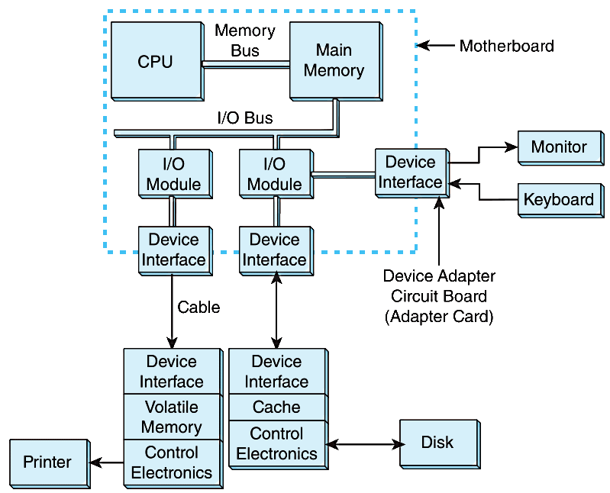
7.4 I/O Architectures
This is a
model I/O
configuration.

Slide 7
7.4 I/O Architectures
I/O can be controlled in five general ways.
Programmed I/O reserves a register for each I/O device. Each register is continually polled to detect data arrival.
Interrupt-Driven I/O allows the CPU to do other things until I/O is requested.
Memory-Mapped I/O shares memory address space between I/O devices and program memory.
Direct Memory Access (DMA) offloads I/O processing to a special-purpose chip that takes care of the details.
Channel I/O uses dedicated I/O processors.

Slide 8
Programmed I/O
CPU has direct control over I/O
After issued command, CPU must wait for I/O module to complete operation
If processor is faster than the I/O, Wastes CPU time
E.g. legacy mouse controller
If the mouse has moved, the command buffer will flag this
The CPU can then fetch the mouse data and act accordingly
very expensive and wastes processor time
Wastes CPU time, since the mouse may not have moved between polling cycles.
Other devices, i.e. all legacy serial port, parallel ports, midi, joystick, PS/2 keyboards, interval timers

Slide 9
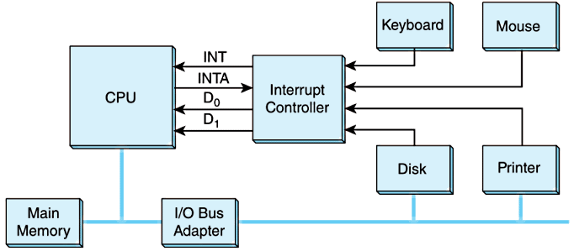
7.4 I/O Architectures: Interrupt-driven
This is an idealized I/O subsystem that uses interrupts.
Each device connects its interrupt line to the interrupt controller.
The controller signals the CPU when any of the interrupt lines are asserted.

Slide 10
7.4 I/O Architectures: Interrupt-driven
Recall from Chapter 4 that in a system that uses interrupts, the status of the interrupt signal is checked at the top of the fetch-decode-execute cycle.
The particular code that is executed whenever an interrupt occurs is determined by a set of addresses called interrupt vectors that are stored in low memory.
The system state is saved before the interrupt service routine is executed and is restored afterward.
We provide a flowchart on the next slide.

Slide 11
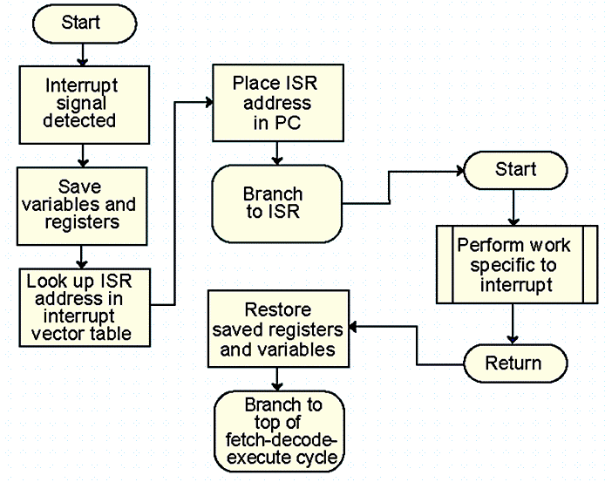
7.4 I/O Architectures: Interrupt driven

Slide 12
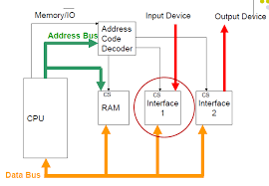
7.4 I/O Architectures: Memory-mapped
In memory-mapped I/O devices and main memory share the same address space.
Each I/O device has its own reserved block of memory.
Memory-mapped I/O therefore looks just like a memory access from the point of view of the CPU.
Thus the same instructions to move data to and from both I/O and memory, greatly simplifying system design.
In small systems the low-level details of the data transfers are offloaded to the I/O controllers built into the I/O devices.

Slide 13
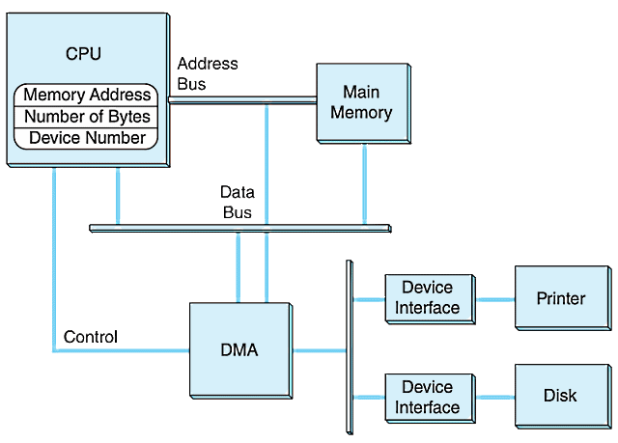
7.4 I/O Architectures: Direct Memory Access
This is a DMA configuration.
Notice that the DMA and the CPU share the bus.
The DMA runs at a higher priority and steals memory cycles from the CPU.

Slide 14
7.4 I/O Architectures: Channel I/O
Very large systems employ channel I/O.
Channel I/O processors (IOPs) I/O consists of one or more that control various channel paths.
Slower devices such as terminals and printers are combined (multiplexed) into a single faster channel.
On IBM mainframes, multiplexed channels are called multiplexor channels, the faster ones are called selector channels.

Slide 15
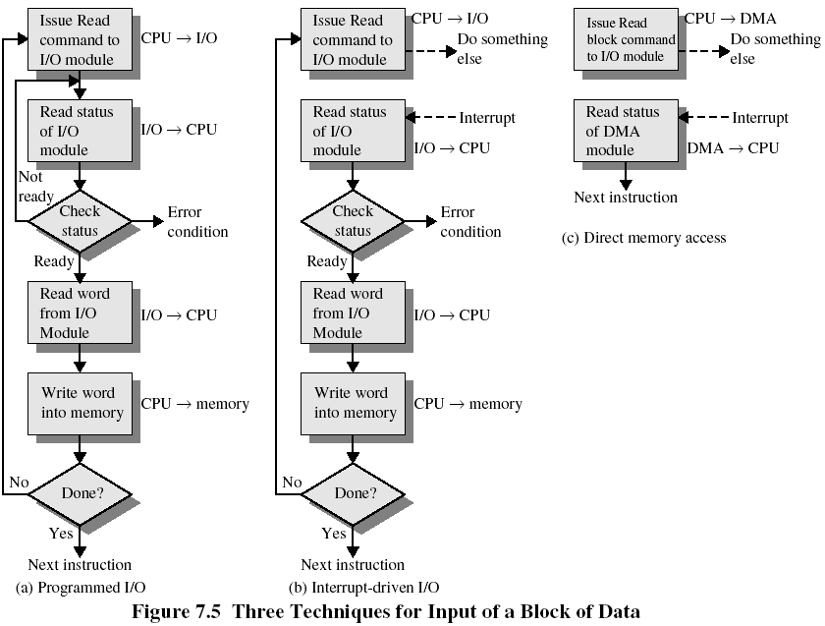
3 Techniques
for Inputting
a block of Data into the main memory

Slide 16
7.4 I/O Architectures: Channel I/O
Channel I/O is distinguished from DMA by the intelligence of the IOPs.
The IOP negotiates protocols, issues device commands, translates storage coding to memory coding, and can transfer entire files or groups of files independent of the host CPU.
The host has only to create the program instructions for the I/O operation and tell the IOP where to find them.

Slide 17
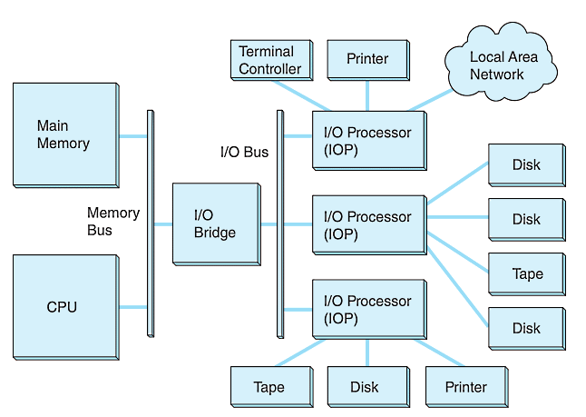
7.4 I/O Architectures: Channel I/O
This is a channel I/O configuration.

Slide 18
7.4 I/O Architectures
Character I/O devices process one byte (or character) at a time.
Examples include modems, keyboards, and mice.
Keyboards are usually connected through an interrupt-driven I/O system.
Block I/O devices handle bytes in groups.
Most mass storage devices (disk and tape) are block I/O devices.
Block I/O systems are most efficiently connected through DMA or channel I/O.

Slide 19
7.4 I/O Architectures
I/O buses, unlike memory buses, operate asynchronously. Requests for bus access must be arbitrated among the devices involved.
Bus control lines activate the devices when they are needed, raise signals when errors have occurred, and reset devices when necessary.
The number of data lines is the width of the bus.
A bus clock coordinates activities and provides bit cell boundaries.

Slide 20
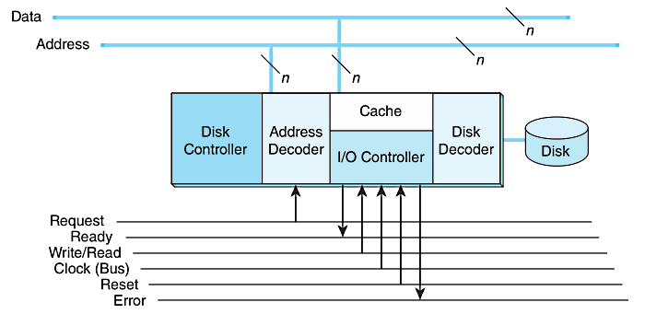
7.4 I/O Architectures
This is how a bus connects to a disk drive.

Slide 21
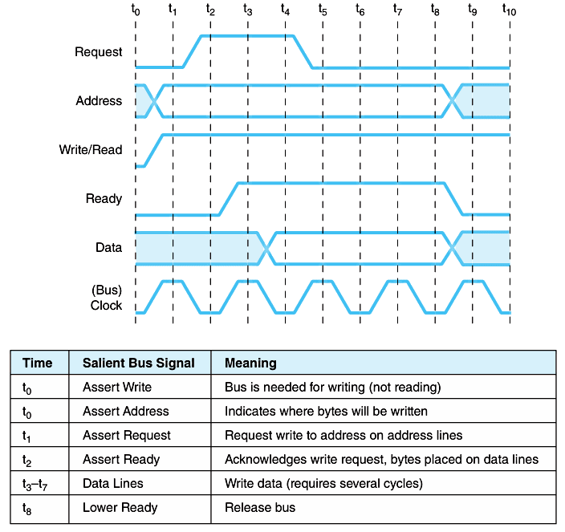
Timing diagrams, such as this one, define bus operation in detail.

Slide 22
External storage

Slide 23
7.6 Magnetic Disk Technology
Magnetic disks offer large amounts of durable storage that can be accessed quickly.
Disk drives are called random (or direct) access storage devices, because blocks of data can be accessed according to their location on the disk.
This term was coined when all other durable storage (e.g., tape) was sequential.
Magnetic disk organization is shown on the following slide.

Slide 24
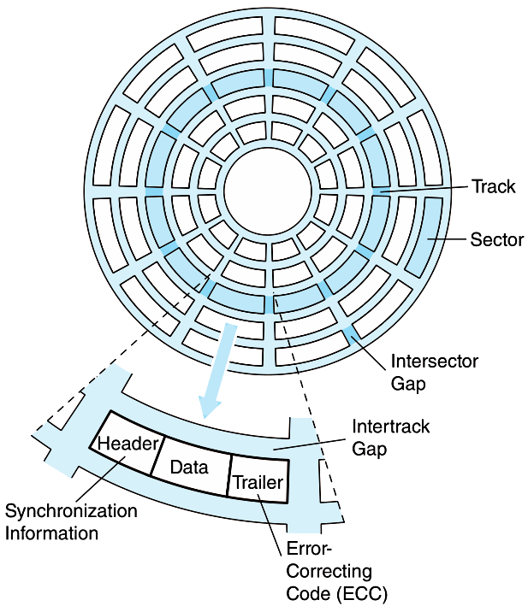
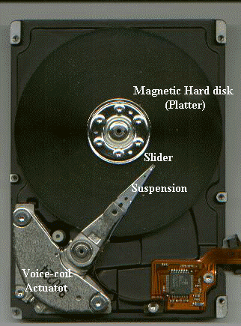
7.6 Magnetic Disk Technology
Disk tracks are numbered from the outside edge, starting with zero.

Slide 25
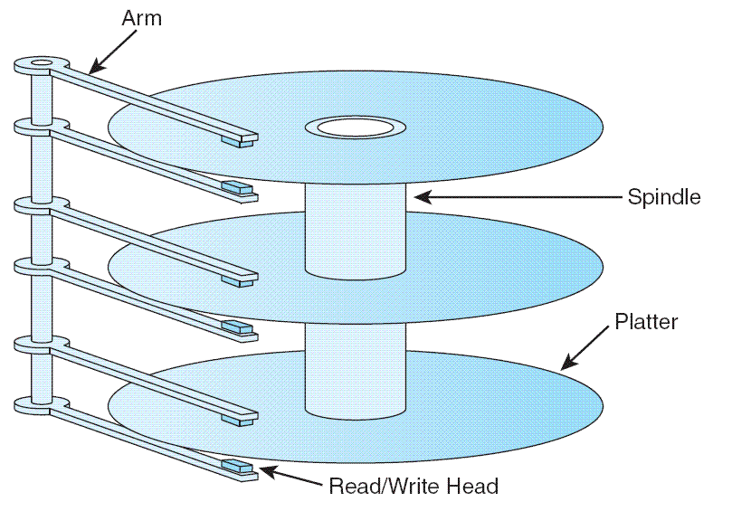
7.6 Magnetic Disk Technology
Hard disk platters are mounted on spindles.
Read/write heads are mounted on a comb that swings radially to read the disk.

Slide 26
7.6 Magnetic Disk Technology
The rotating disk forms a logical cylinder beneath the read/write heads.
Data blocks are addressed by their cylinder, surface, and sector.

Slide 27
7.6 Magnetic Disk Technology
There are a number of electromechanical properties of hard disk drives that determine how fast its data can be accessed.
Seek time is the time that it takes for a disk arm to move into position over the desired cylinder.
Rotational delay is the time that it takes for the desired sector to move into position beneath the read/write head.
Seek time + rotational delay = access time.

Slide 28
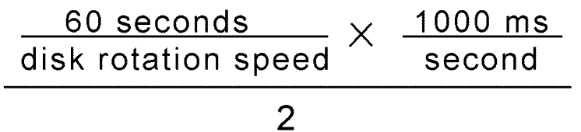
7.6 Magnetic Disk Technology
Transfer rate gives us the rate at which data can be read from the disk.
Average latency is a function of the rotational speed:
Mean Time To Failure (MTTF) is a statistically-determined value often calculated experimentally.
It usually doesn’t tell us much about the actual expected life of the disk. Design life is usually more realistic.
Figure 7.15 in the text shows a sample disk specification.

Slide 29
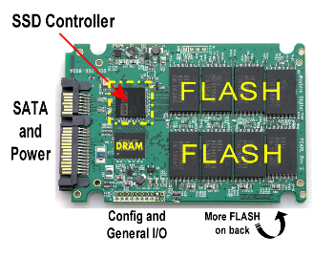
7.6 Magnetic Disk Technology
Low cost is the major advantage of hard disks.
But their limitations include:
Very slow compared to main memory
Fragility
Moving parts wear out
Reductions in memory cost enable the widespread adoption of solid state drives, SSDs.
Computers "see" SSDs as jut another disk drive, but they store data in non-volatile flash memory circuits.
Flash memory is also found in memory sticks and MP3 players.

Slide 30
7.6 Magnetic Disk Technology
SSD access time and transfer rates are typically 100 times faster than magnetic disk, but slower than onboard RAM by a factor of 100,000.
There numbers vary widely among manufacturers and interface methods.
Unlike RAM, flash is block-addressable (like disk drives).
The duty cycle of flash is between 30,000 and 1,000,000 updates to a block.
Updates are spread over the entire medium through wear leveling to prolong the life of the SSD.

Slide 31
7.7 Optical Disks
Optical disks provide large storage capacities very inexpensively.
They come in a number of varieties including CD-ROM, DVD, and WORM.
Many large computer installations produce document output on optical disk rather than on paper. This idea is called COLD-- Computer Output Laser Disk
It is estimated that optical disks can endure for a hundred years. Other media are good for only a decade-- at best.
Notes:
Cd-da = compact disc- digital audio
CD data (in Mbytes) = 44100 sampling * 2 channels * 16 bits for resolution * 60 (if in minutes) * minutes / 8 bits

Slide 32
7.7 Optical Disks
CD-ROMs were designed by the music industry in the 1980s, and later adapted to data.
This history is reflected by the fact that data is recorded in a single spiral track, starting from the center of the disk and spanning outward.
Binary ones and zeros are delineated by bumps in the polycarbonate disk substrate. The transitions between pits and lands define binary ones.
If you could unravel a full CD-ROM track, it would be nearly five miles (~8 km) long!

Slide 33
7.7 Optical Disks
The logical data format for a CD-ROM is much more complex than that of a magnetic disk.
Different formats are provided for data and music.
Two levels of error correction are provided for the data format.
Because of this, a CD holds at most 650MB of data, but can contain as much as 742MB of music.

Slide 34
7.7 Optical Disks
DVDs can be thought of as quad-density CDs.
Varieties include single sided, single layer, single sided double layer, double sided double layer, and double sided double layer.
Where a CD-ROM can hold at most 650MB of data, DVDs can hold as much as 17GB.
One of the reasons for this is that DVD employs a laser that has a shorter wavelength than the CD’s laser.
This allows pits and lands to be closer together and the spiral track to be wound tighter.

Slide 35
7.7 Optical Disks
A shorter wavelength light can read and write bytes in greater densities than can be done by a longer wavelength laser.
This is one reason that DVD’s density is greater than that of CD.
The 405 nm wavelength of blue-violet light is much shorter than either red (750 nm) or orange (650 nm).
The manufacture of blue-violet lasers can now be done economically, bringing about the next generation of laser disks.

Slide 36
7.7 Optical Disks
The Blu-Ray disc format won market dominance over HD-CD owing mainly to the influence of Sony.
HD-CDs are backward compatible with DVD, but hold less data.
Blu-Ray was developed by a consortium of nine companies that includes Sony, Samsung, and Pioneer.
Maximum capacity of a single layer Blu-Ray disk is 25GB.
Multiple layers can be "stacked" up to six deep.
Only double-layer disks are available for home use.

Slide 37
7.7 Optical Disks
Blue-violet laser disks are also used in the data center.
The intention is to provide a means for long term data storage and retrieval.
Two types are now dominant:
Sony’s Professional Disk for Data (PDD) that can store 23GB on one disk and
Plasmon’s Ultra Density Optical (UDO) that can hold up to 30GB.
It is too soon to tell which of these technologies will emerge as the winner.

Slide 38
7.9 RAID
RAID, an acronym for Redundant Array of Independent Disks was invented to address problems of disk reliability, cost, and performance.
In RAID, data is stored across many disks, with extra disks added to the array to provide error correction (redundancy).
The inventors of RAID, David Patterson, Garth Gibson, and Randy Katz, provided a RAID taxonomy that has persisted for a quarter of a century, despite many efforts to redefine it.

Slide 39
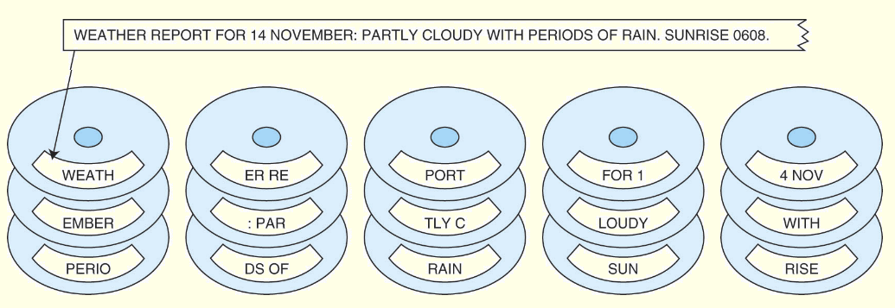
7.9 RAID
RAID Level 0, also known as drive spanning, provides improved performance, but no redundancy.
Data is written in blocks across the entire array
The disadvantage of RAID 0 is in its low reliability.

Slide 40
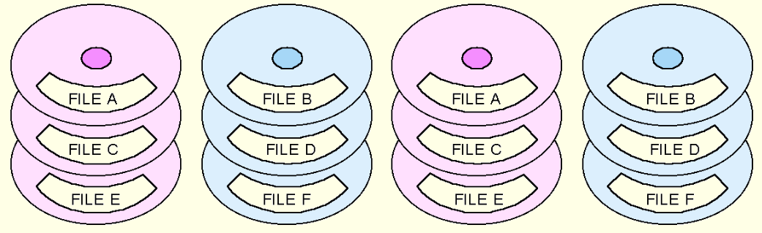
7.9 RAID
RAID Level 1, also known as disk mirroring, provides 100% redundancy, and good performance.
Two matched sets of disks contain the same data.
The disadvantage of RAID 1 is cost.

Slide 41
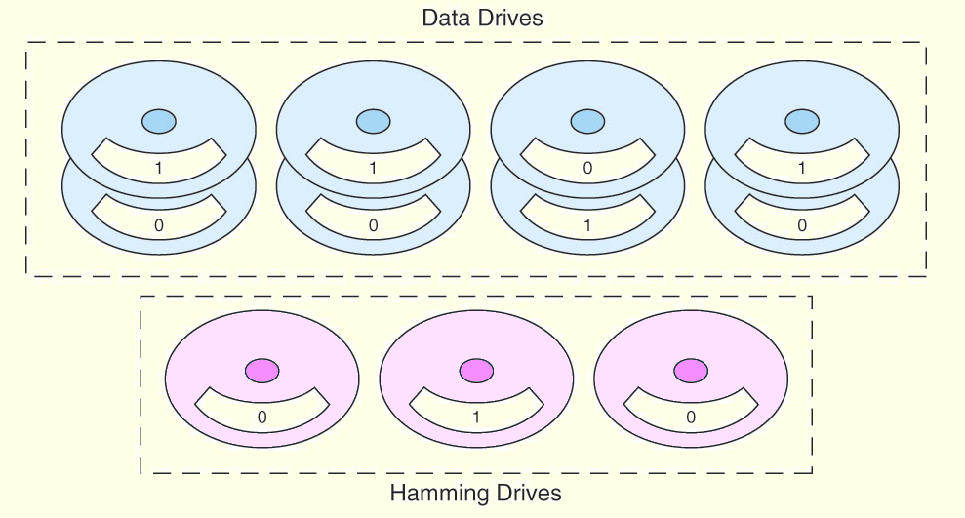
7.9 RAID
A RAID Level 2 configuration consists of a set of data drives, and a set of Hamming code drives.
Hamming code drives provide error correction for the data drives.
RAID 2 performance is poor and the cost is relatively high.

Slide 42
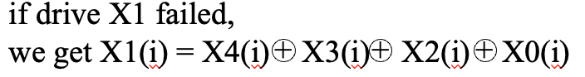
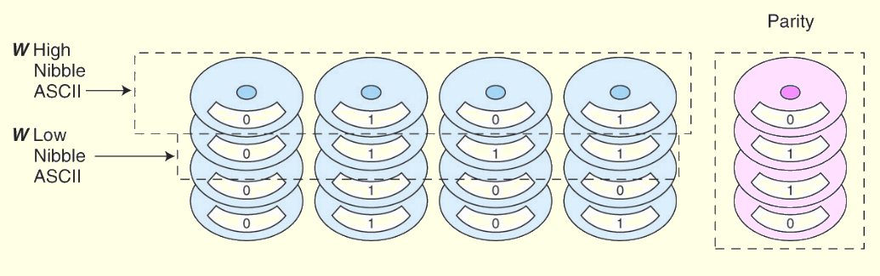
7.9 RAID
RAID Level 3 stripes bits across a set of data drives and provides a separate disk for parity.
Parity is the XOR of the
data bits.
-RAID 3 is not suitable for commercial applications, but is good for personal systems.

Slide 43
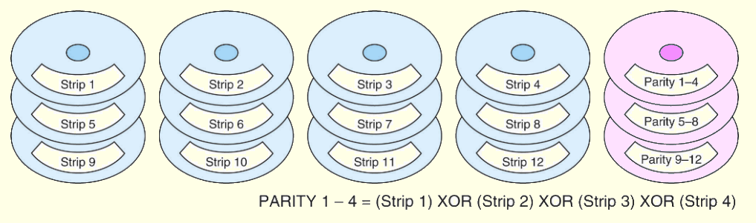
7.9 RAID
RAID Level 4 is like adding parity disks to RAID 0.
Data is written in blocks across the data disks, and a parity block is written to the redundant drive.
RAID 4 would be feasible if all record blocks were the same size.

Slide 44
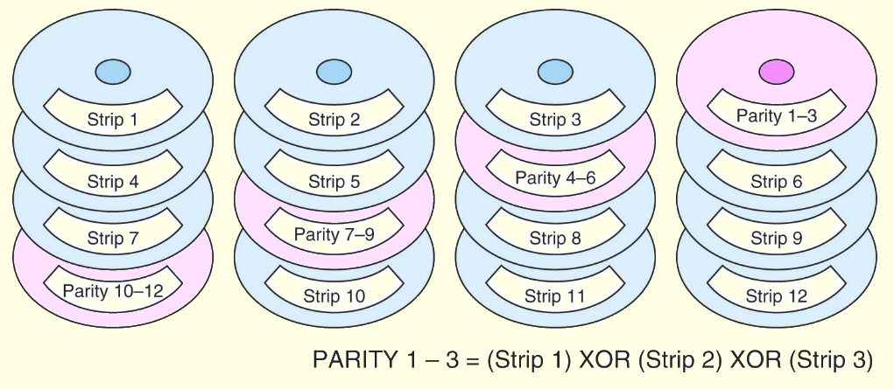
7.9 RAID
RAID Level 5 is RAID 4 with distributed parity.
With distributed parity, some accesses can be serviced concurrently, giving good performance and high reliability.
RAID 5 is used in many commercial systems.

Slide 45
RAID-5
RAID Level 5 is RAID 4 with distributed parity (= load balancing).
With distributed parity, some accesses can be serviced concurrently, giving good performance and high reliability.
E.g. we can write strip 6 and strip 7 at the same time, why?
The most complex disk controller

Slide 46
Updating parity bit in RAID 4 and 5
Old parity strip
Old data strip

Slide 47
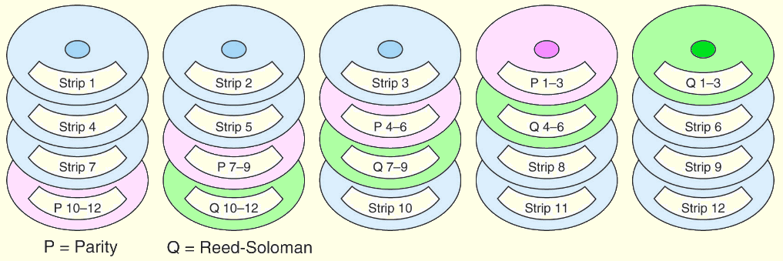
7.9 RAID
RAID Level 6 carries two levels of error protection over striped data: Reed-Soloman and parity.
It can tolerate the loss of two disks.
RAID 6 is write-intensive, but highly fault-tolerant.

Slide 48
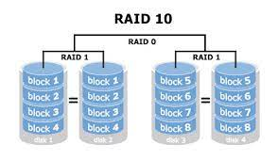
7.9 RAID
Large systems may employ various RAID levels, depending on the criticality of the data on the drives.
Critical, high-throughput files can benefit from combining RAID 0 with RAID 1, called RAID 10.
RAID 50 combines striping and distributed parity. For good fault tolerance and high capacity.
Note: Higher RAID levels do not necessarily mean “better” RAID levels. It all depends upon the needs of the applications that use the disks.

Slide 49
7.10 The Future of Data Storage
Advances in technology have defied all efforts to define the ultimate upper limit for magnetic disk storage.
In the 1970s, the upper limit was thought to be around 2Mb/in².
Today’s disks commonly support 20Gb/in².
Improvements have occurred in several different technologies including:
Materials science
Magneto-optical recording heads.
Error correcting codes.

Slide 50
7.10 The Future of Data Storage
Present day biological data storage systems combine organic compounds such as proteins or oils with inorganic (magentizable) substances.
Early prototypes have encouraged the expectation that densities of 1Tb/in² are attainable.
Of course, the ultimate biological data storage medium is DNA.
Trillions of messages can be stored in a tiny strand of DNA.
Practical DNA-based data storage is most likely decades away.

Slide 51
Chapter 7 Conclusion
I/O systems are critical to the overall performance of a computer system.
I/O systems consist of memory blocks, cabling, control circuitry, interfaces, and media.
I/O control methods include programmed I/O, interrupt-based I/O, DMA, and channel I/O.

Slide 52
Chapter 7 Conclusion
Magnetic disk is the principal form of durable storage.
Disk performance metrics include seek time, rotational delay, and reliability estimates.
Enterprise SSDs save energy and provide improved data access for government and industry.
Optical disks provide long-term storage for large amounts of data, although access is slow.

Slide 53
Chapter 7 Conclusion
RAID gives disk systems improved performance and reliability. RAID 3 and RAID 5 are the most common.
RAID 6 protect against dual disk failure
Any one of several new technologies including biological may someday replace magnetic disks.
The hardest part of data storage may be in locating the data after it’s stored.

